Slide 1
Master Thesis Updates
Moritz Sölderer

Slide 2
17.04.2026

Slide 3
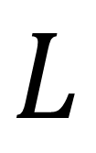
Background on Peer Incentivation
How to achieve Cooperation between Agents?
Joint Objective (Centralized)
Peer Incentivation (Decentralized)
MATE: fixed Token
DRIVE: Token dependent on Epoch-Average Rewards
$$L$$

Slide 4
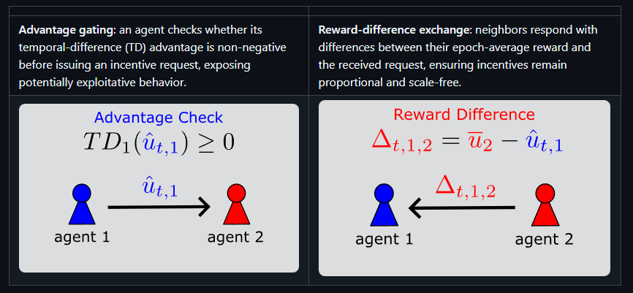
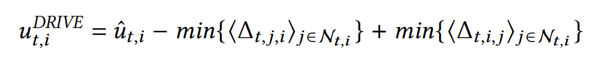
DRIVE: Dynamic Reward Incentives for Variable Exchange
Peer Incentivation via Reward Shaping
2-step protocol
Invariant under Reward-Drift

Slide 5
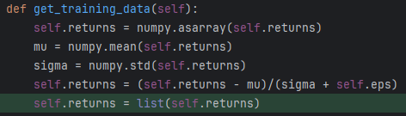
Small Changes to DRIVE-Reposority
Experiments do not seem to be executable out-of-the-box
Minor changes I had to make:
settings.py
(torch does not recognize „gpu“)
memory.py
(Can‘t call .clear() on np.ndarray)
environment.py
(numpy.int is deprecated)

Slide 6
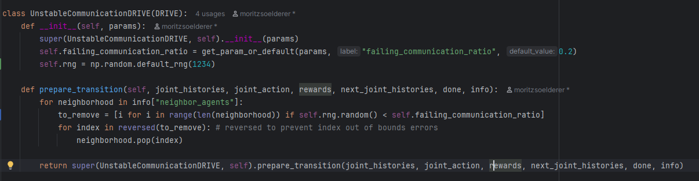
Communication Failure
parameters: failing_communication_ratio
Idea: each agent has x% chance that its DRIVE-Response gets lost
Implementation: remove agents from neighborhoods with x% chance before DRIVE exchange
Edges of neighborhood graph are removed?

Slide 7
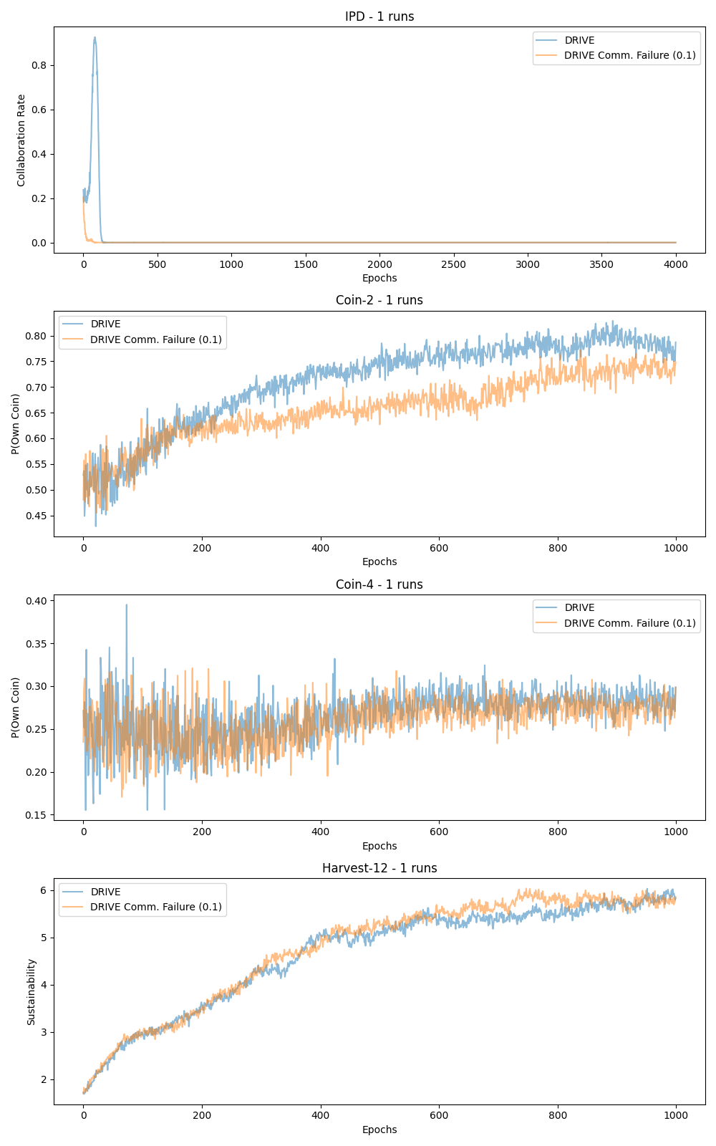
Communication Failure (10% Prob.)

Slide 8
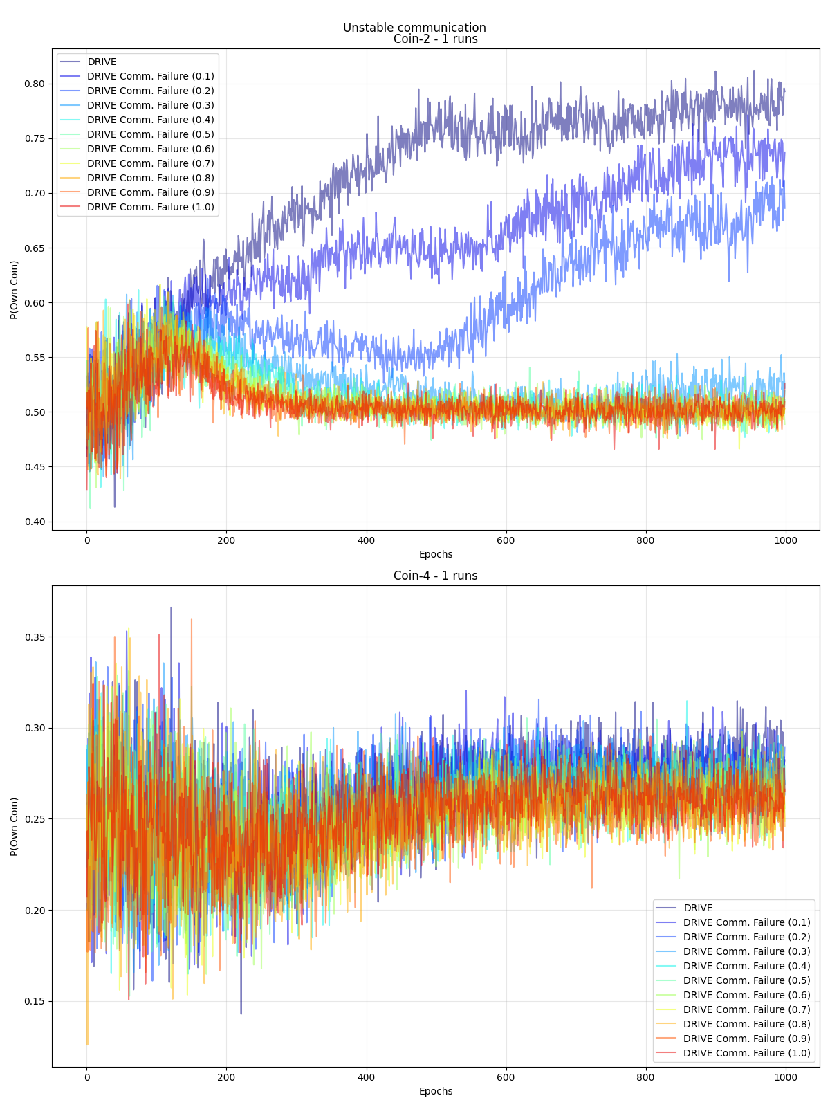
Communication Failure
IDP: very strange results for DRIVE
Harvest: takes very long

Slide 9
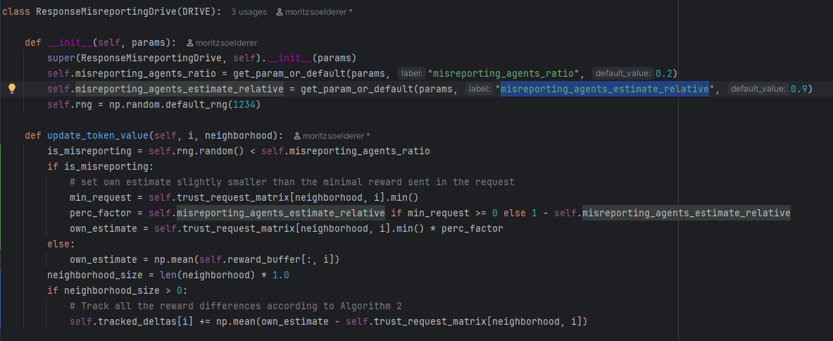
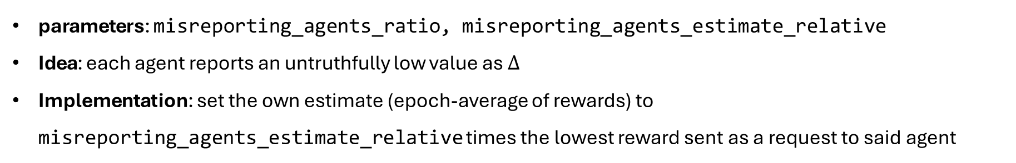
Response Misreporting
parameters: misreporting_agents_ratio, misreporting_agents_estimate_relative
Idea: each agent reports an untruthfully low value as $Δ$
Implementation: set the own estimate (epoch-average of rewards) to misreporting_agents_estimate_relative times the lowest reward sent as a request to said agent

Slide 10
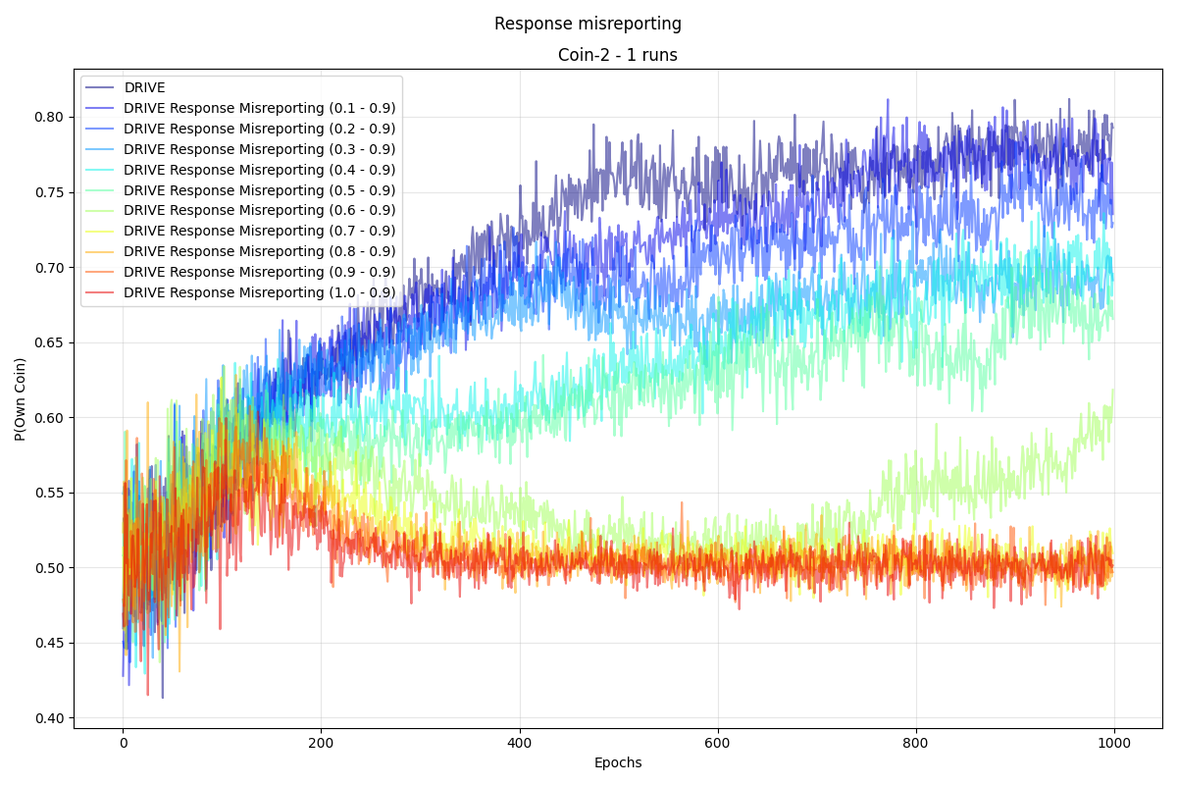
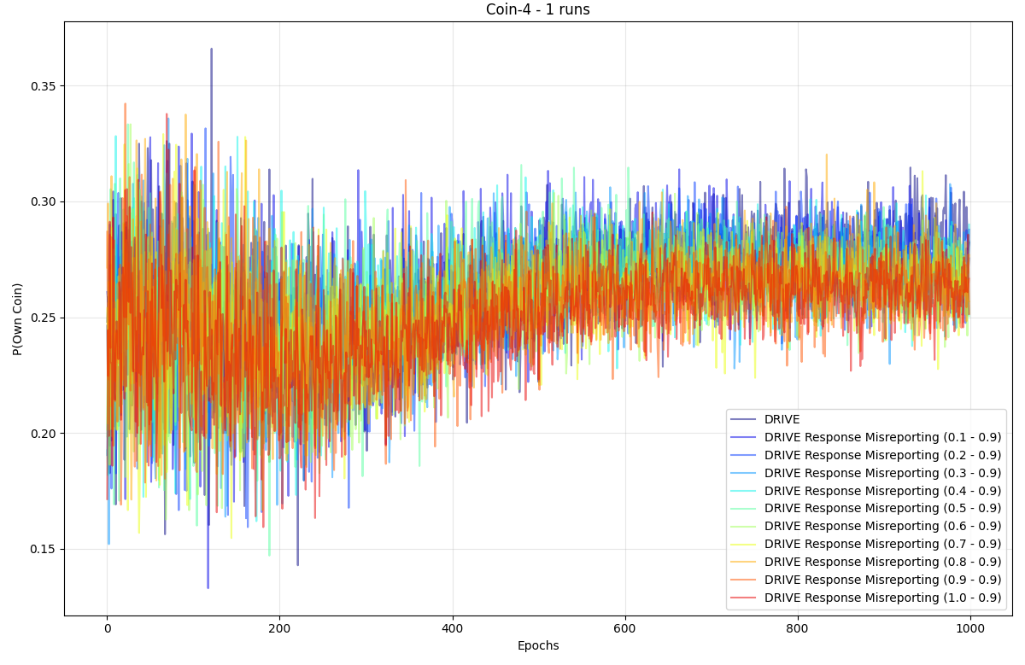
Response Misreporting
IDP: very strange results for DRIVE
Harvest: takes very long

Slide 11
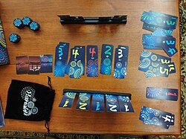
Additional Environments (Thoughts):
Hanabi (2 or 3 players) used by Google Deepmind [Google Deepmind|Hanabi]

Slide 12
23.04.2026

Slide 13
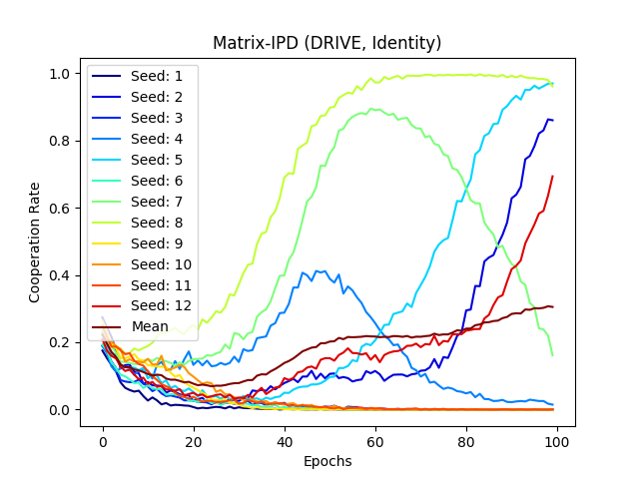
Debugging DRIVE-Repository
First Idea: search for bugs in code → unfortunately not succesful
Second Idea: set seeds for reproducibility; different runs, different results?
Some seeds perform well, some very bad...
Cooperation Rate rises on avg!
Third Idea: DRIVE seems to do its job, the random numbers mess it up → Neural Network Initialization?

Slide 14
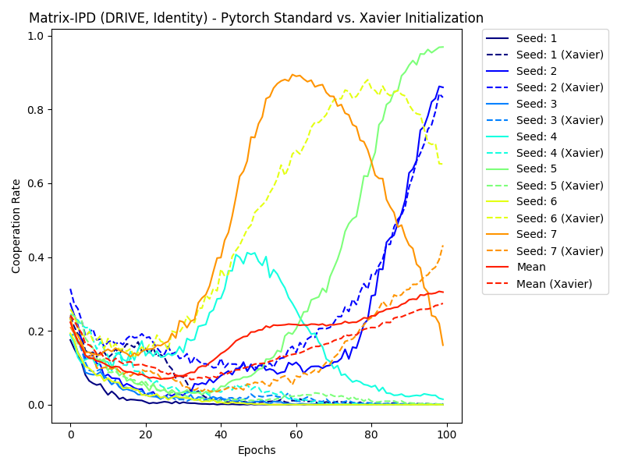
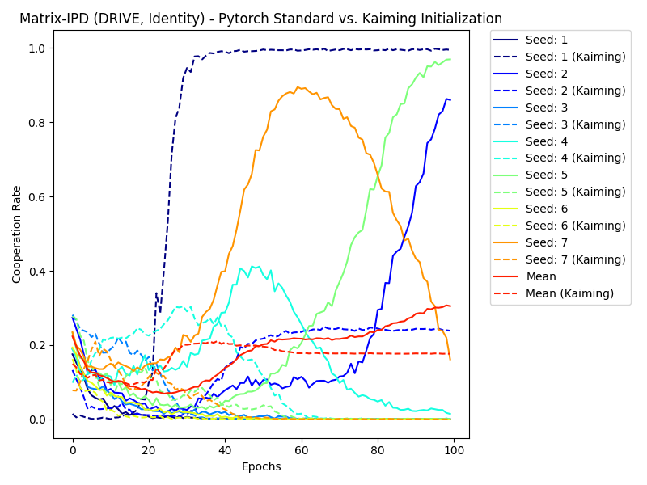
Debugging DRIVE-Repository
Xavier and Kaiming Initialization
No clear pattern, no improvement

Slide 15
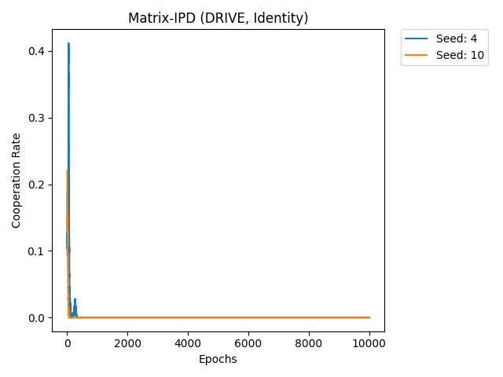
Debugging DRIVE-Repository
Thoughts:
There seems to be no other influence of random numbers
DRIVE is a deterministic protocol → its performance should not be dependent on randomness
Especially hill-like graphs (e.g. seed = 4 or 7) indicate that information is shared, yet not used
Averaged collaboration rate (over all seeds) rises
Best Guesses (for now):
optimizer gets stuck in local minimum and/or
actor critic collapses to single action
So most likely a learning failure?

Slide 16
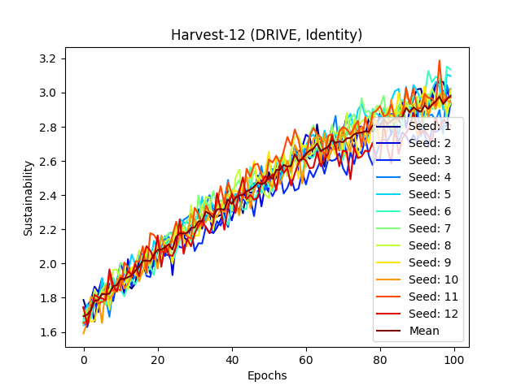
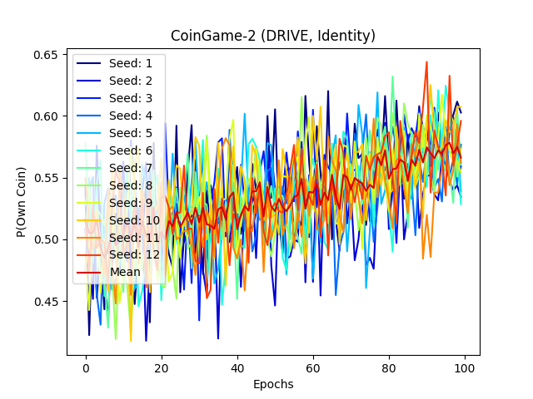
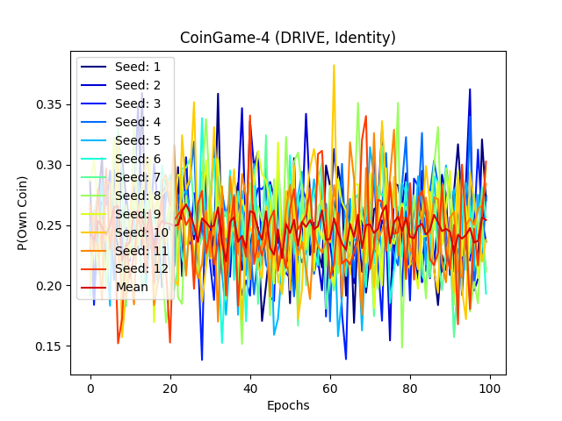
Debugging DRIVE-Repository
However, Harvest-12 & CoinGame-2 work fine for all seeds, and CoinGame-4 does not work at all
So maybe a bug in the IDP/CoinGame-4 Environments?
The only difference between CoinGame-4 & CoinGame-2 is nr. of agents & size of board...

Slide 17
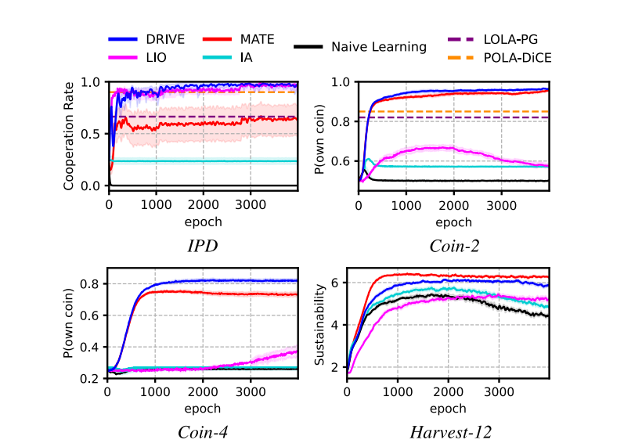
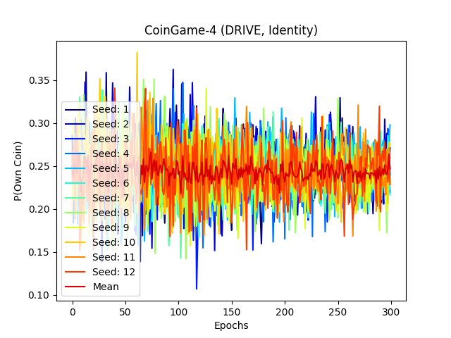
Debugging DRIVE-Repository
Results from Paper
CoinGame-4 (300 Epochs)

Slide 18
30.04.2026

Slide 19
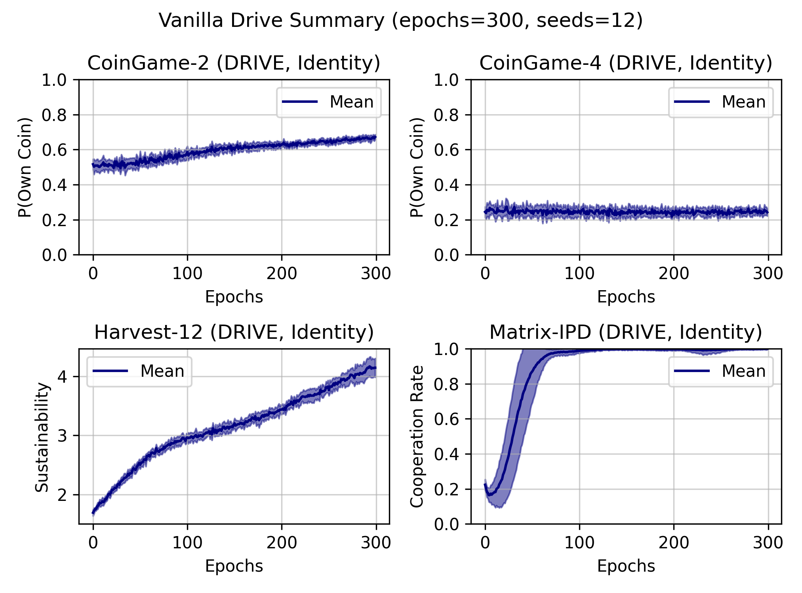
DRIVE-Repository Bug-Solution (Undiscounted Returns)
Omit multiplication with discount factor ($γ$)

Slide 20
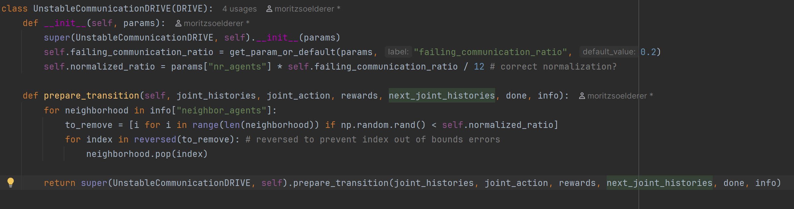
Unstable Communication (Updated)
Normalize ratio of misreporting agents (correct?)

Slide 21
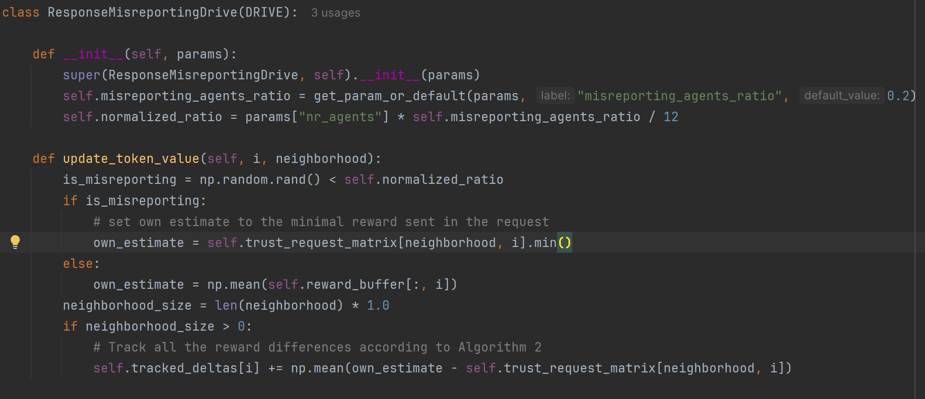
Response Misreporting (Updated)
Directly report min. reward
Normalize ratio of misreporting agents (correct?)

Slide 22
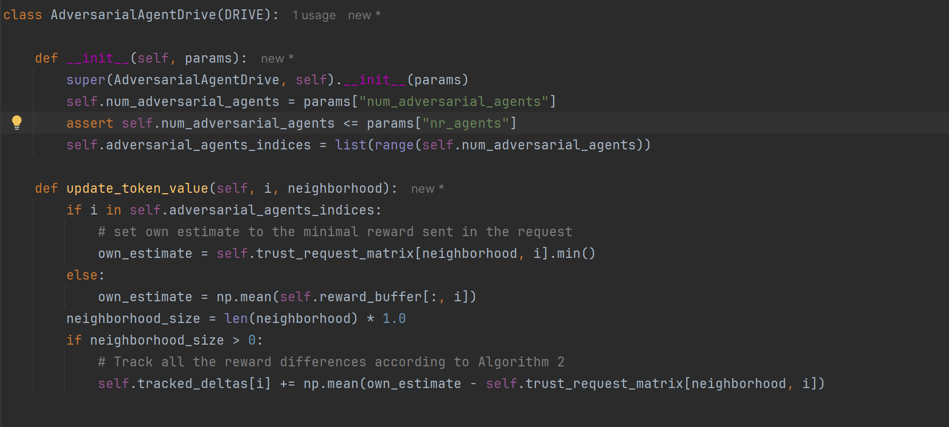
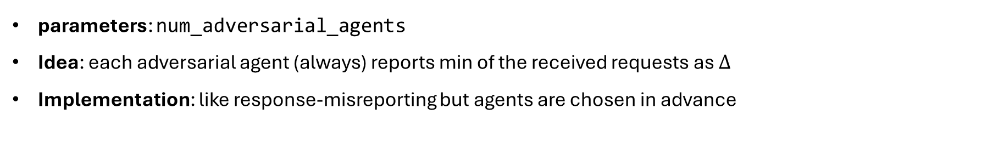
Adversarial Agents (New)
parameters: num_adversarial_agents
Idea: each adversarial agent (always) reports min of the received requests as $Δ$
Implementation: like response-misreporting but agents are chosen in advance

Slide 23
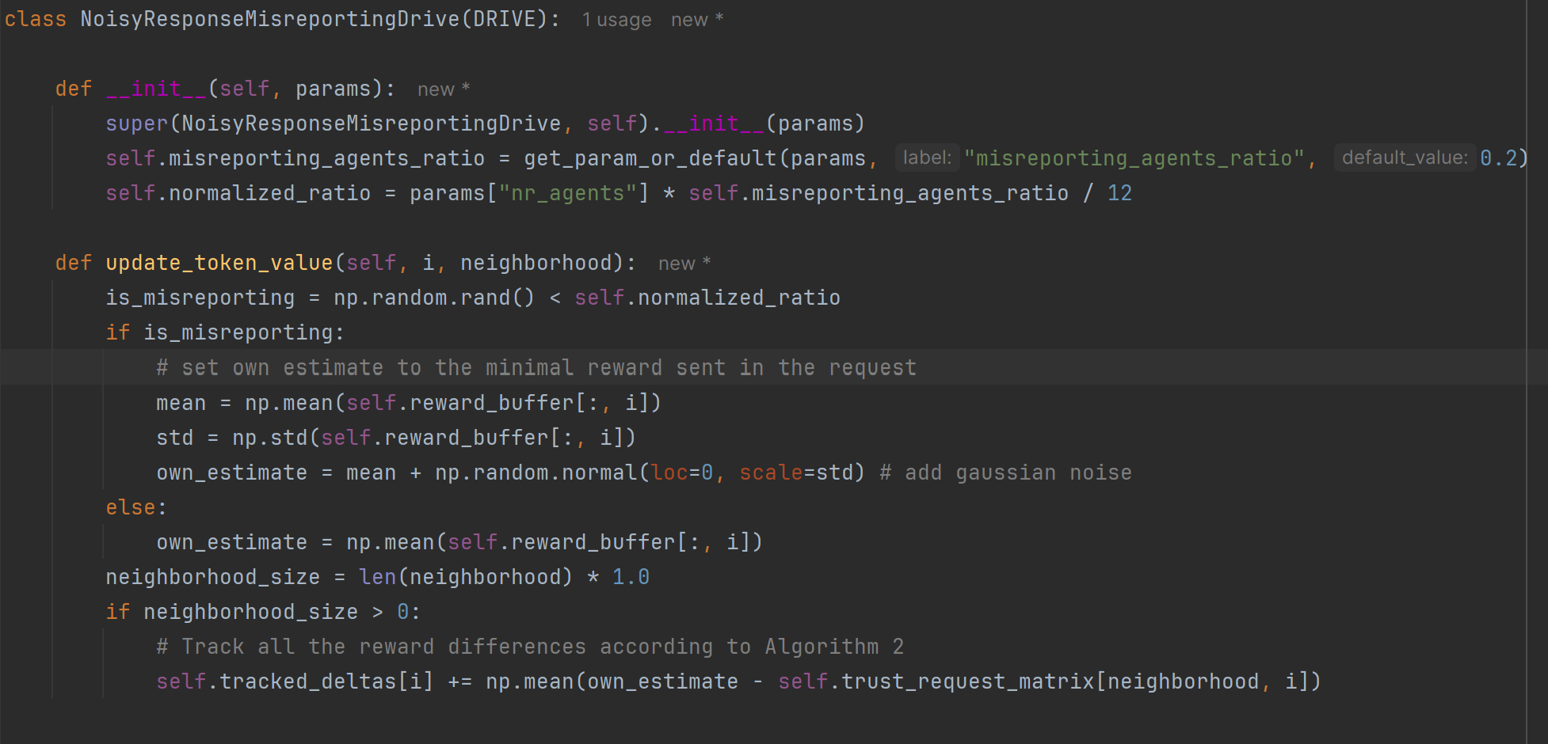
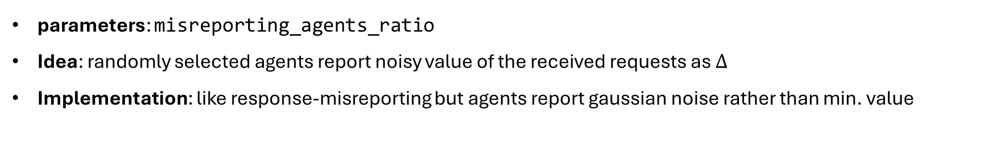
Noisy Misreporting (New)
parameters: misreporting_agents_ratio
Idea: randomly selected agents report noisy value of the received requests as $Δ$
Implementation: like response-misreporting but agents report gaussian noise rather than min. value

